Slide 1

App Store Analysis

Slide 2
Agenda
Introduction
Market Penetration Opportunities
Lowest Rated Apps
Final takeaways

Slide 3
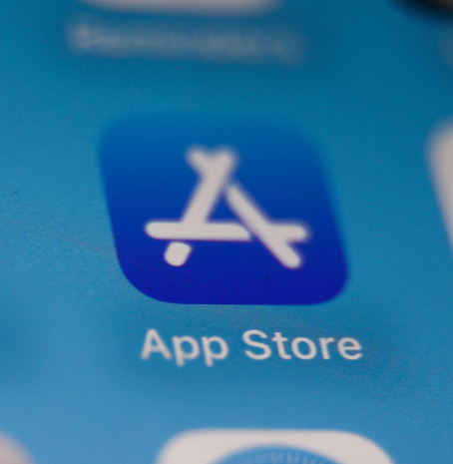
Introduction

Slide 4
Project Objective
A company is looking to expand into the mobile applications market and is looking for insight to help determine whether their app should be free or paid
Identify market trends and opportunities for growth and profit using data analysis for support
Determine a price point for the company to maximize profits and consumer engagements in the App Store

Slide 5

Market Penetration Opportunities

Slide 6
Market Penetration
Almost 50% of all apps in the App Store are Games, followed by Entertainment and Education apps.
App genres with the least market share in the App Store include:
Medical
Navigation
Business

Slide 7
Market Penetration
Higher user ratings for paid apps indicate opportunities for profit
Business and Navigation apps have a low market share and low rated apps $10 or more, highlights opportunities for market penetration

Slide 8
Lowest Rated Apps

Slide 9
Opportunities for Improvement
Various overlap in terms of lowest rated apps. Sports, Entertainment, News and Finance apps have the lowest user rating even for well-established apps with over 100,000 reviews

Slide 10
Opportunities for Improvement
Apps that offer support for 10-20 languages have the highest user ratings
Apps that support 20-30 languages have lower reviews, highlighting an opportunity to provide better support or translations to more languages.

Slide 11

Summary
The business should create an app in the following genres:
Business
Navigation
Both genres have a small number of apps in the App Store, meaning less competition.
Both Business and Navigation apps also have the lowest user ratings in all genres for paid apps creating opportunities to provide better products for consumers.

